Slide 1
Secure Network Design,
Firewall Configuration & Attack Simulation
Group 11 – Network Security Project
VAMSHI KRISHNA MUNIGANTI
VAMSI KRISHNA VEMURI
Tools: GNS3, Fortigate, Cisco Router, Windows, Ubuntu, Kali Linux

Slide 2
Project Overview
Designed a segmented internal network in GNS3.
Implemented firewall policies and routing using a FortiGate firewall and Cisco router.
Built a fully offline cyber range for safe attack testing.
Simulated DoS and port scan attacks from Kali Linux to a Windows 10 host.
Captured packet flows and analyzed firewall logs for behavior.

Slide 3
Final Network Topology
Kali Linux – Attacker
Windows 10 – Victim / Workstation
Ubuntu – Internal server
FortiGate – Firewall and traffic inspection
Cisco R1 – Router and inter-LAN gateway
ESW1 – Layer 2 switch for LAN distribution

Slide 4
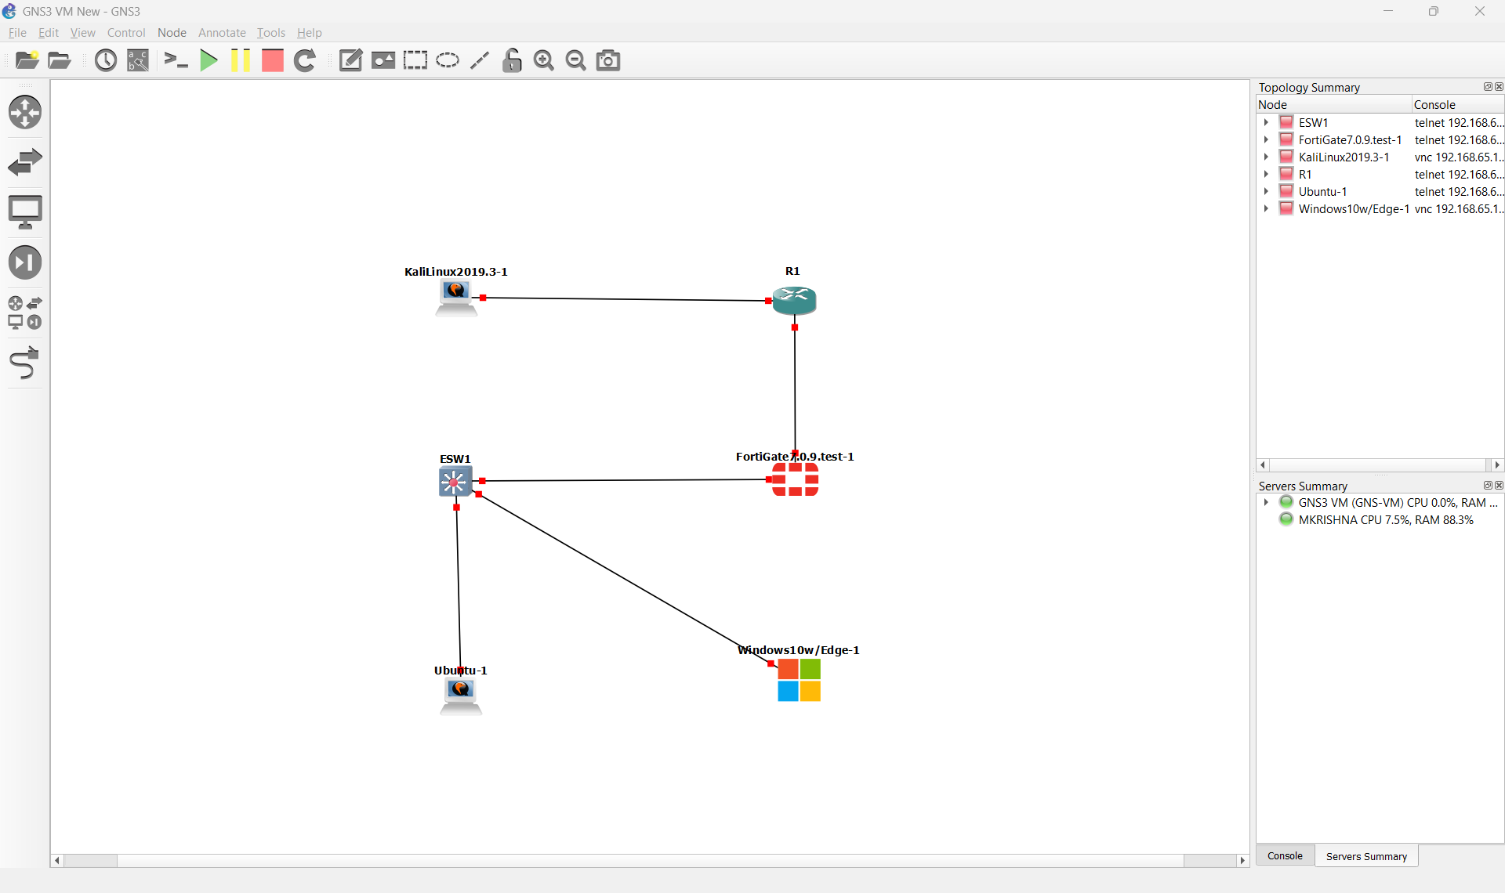

Slide 5
IP Addressing Scheme
Windows LAN:
• Network: 192.168.10.0/24
• Example host: 192.168.10.30
• Default gateway: 192.168.10.1 (FortiGate port3)
Kali LAN:
• Network: 192.168.20.0/24
• Gateway: 192.168.20.1 (R1 Fa0/1)
Router–Firewall Transit:
• Network: 10.0.0.0/24
• R1: 10.0.0.1
• FortiGate port2: 10.0.0.2
Ubuntu:
• 192.168.10.x

Slide 6
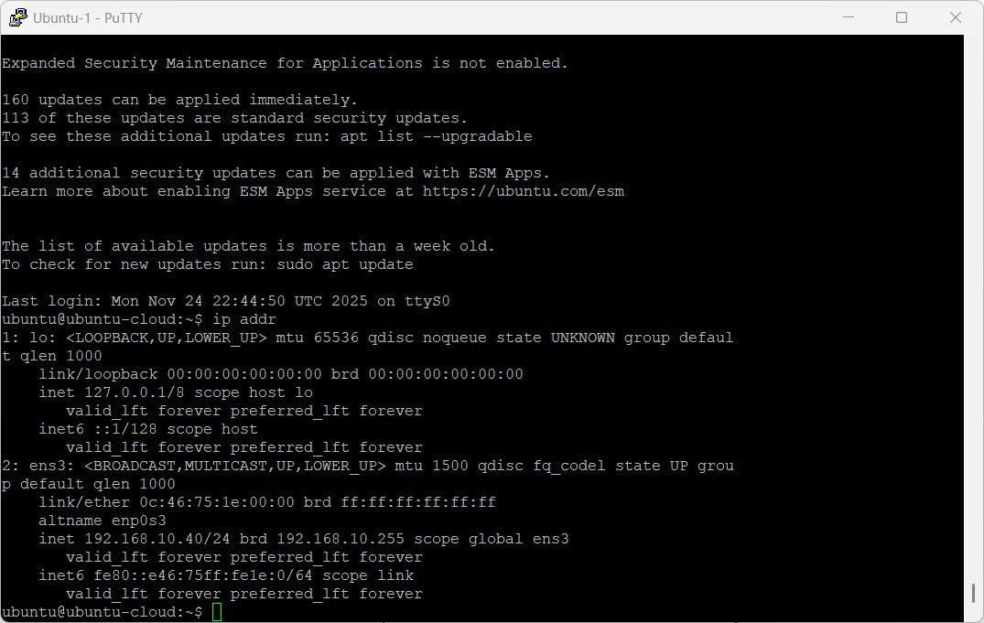

Slide 7
Router R1 Configuration
Interfaces:
• FastEthernet0/0 = 10.0.0.1
• FastEthernet0/1 = 192.168.20.1
Static Routing:
ip route 192.168.10.0 255.255.255.0 10.0.0.2
R1 routes traffic between the Kali LAN (192.168.20.0/24) and the Windows/Ubuntu LAN (192.168.10.0/24).
NAT is disabled to keep the lab purely internal and offline.

Slide 8
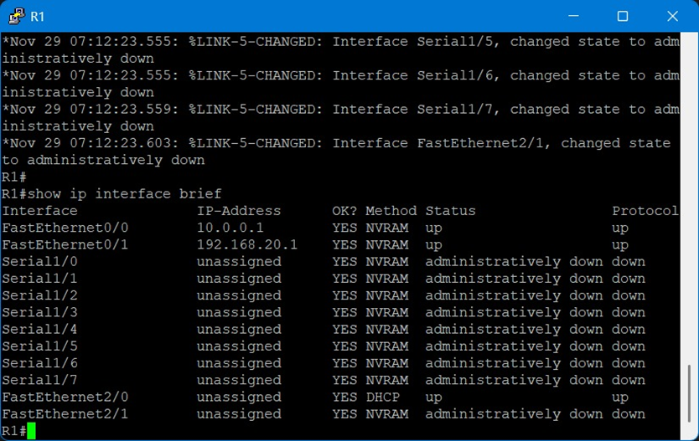

Slide 9
FortiGate Firewall Configuration
Interfaces:
• port3: 192.168.10.1/24 (LAN for Windows & Ubuntu)
• port2: 10.0.0.2/24 (connected to R1)
• port1: Disabled (no internet access in lab)
Core IPv4 Policy (LAN → LAN):
• Source: All internal LANs
• Destination: All internal LANs
• Action: ACCEPT
• NAT: Disabled
• Logging: Enabled

Slide 10
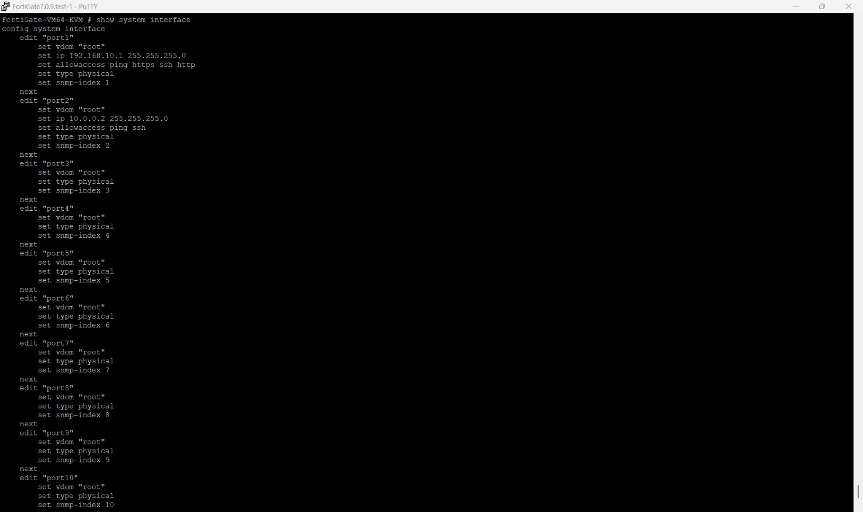

Slide 11
Switch ESW1 Configuration
Configured as a Layer 2 switch.
VLAN 10 used for Windows and Ubuntu hosts.
Uplink port connected to FortiGate.
Ports verified as up and passing traffic.

Slide 12
Connectivity Testing
Windows → FortiGate: ICMP ping successful.
Kali → Router R1: ICMP ping successful.
Ubuntu → Windows: ICMP ping successful.
Inter-LAN routing validated via ping and traceroute.

Slide 13
Attack Simulation Setup
Attacker: Kali Linux (192.168.20.x).
Victim: Windows 10 (192.168.10.30).
Tools used: nmap (port scanning), hping3 (DoS simulation).
Environment: Fully offline, isolated GNS3 lab.

Slide 14
Attack 1: Port Scan (Reconnaissance)
Kali command: nmap -A 192.168.10.30
Results:
• Discovers open ports and services on the Windows
host.
• Attempts OS and service fingerprinting.
• FortiGate logs multiple TCP connection attempts
from Kali.

Slide 15
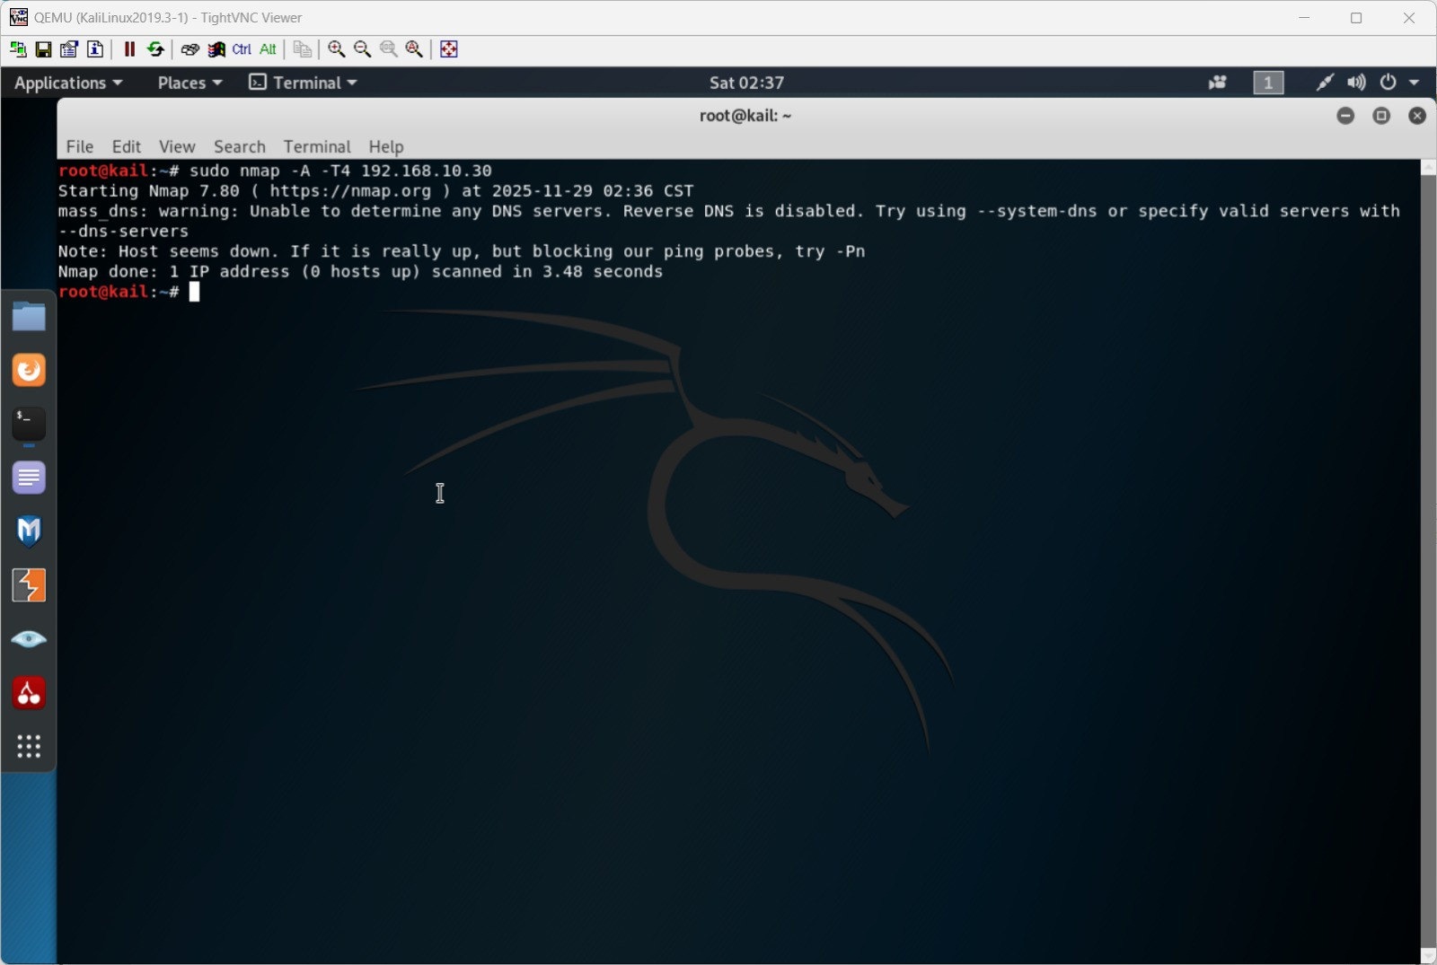

Slide 16
Attack 2: DoS Simulation (Safe SYN Flood)
Kali command:
sudo hping3 -S --flood -V 192.168.10.30
Effects:
• Generates a high volume of TCP SYN packets to the Windows host.
• Simulates a DoS-like scenario inside the isolated lab.
• Windows may show slowdown or higher CPU usage.
• FortiGate logs a spike in traffic from the Kali IP.

Slide 17
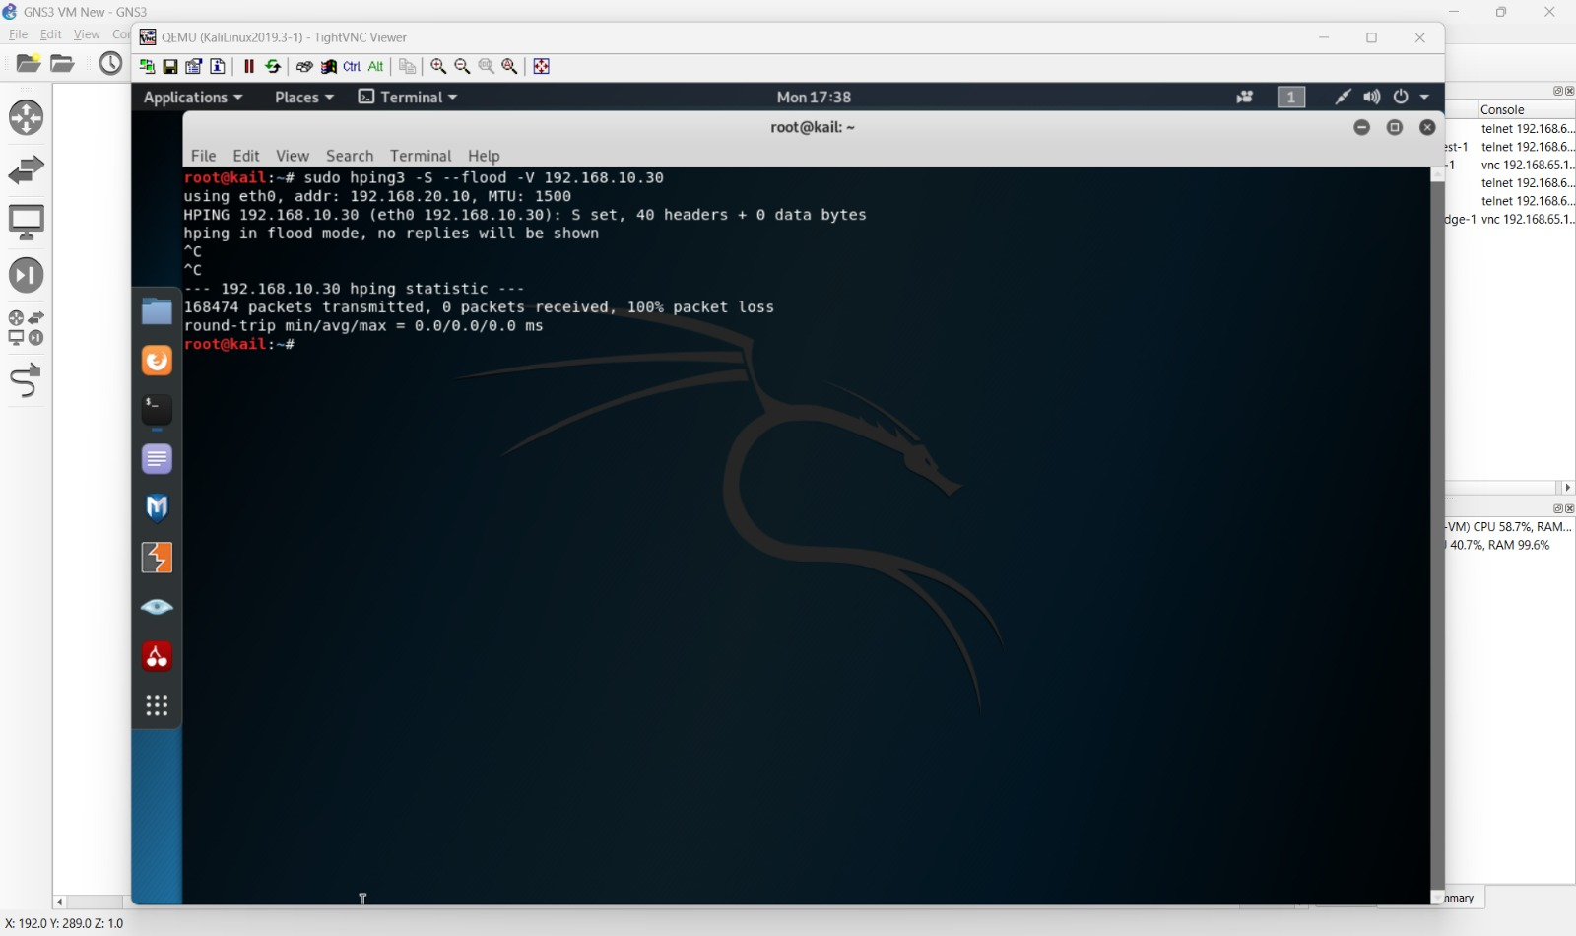

Slide 18
Packet Capture Analysis
Packet capture performed using tools inside GNS3 VM (Wireshark/tshark).
Captured traffic includes:
• ICMP echo requests and replies.
• TCP SYN flood packets.
• ARP broadcasts and responses.
Analysis shows patterns typical of port scanning and DoS behavior.

Slide 19
Firewall Detection & Logs
FortiGate Forward Traffic logs record:
• Source IP (Kali) and destination IP (Windows).
• Protocol and port information for scans and floods.
• Timestamp and policy ID for each session.
Logs provide strong evidence of reconnaissance and DoS-like behavior.
They are useful for incident analysis and reporting.

Slide 20
Mitigation Techniques
Firewall-based controls:
• Enable DoS protection profiles on LAN policies.
• Use IPS signatures to detect common attacks.
• Apply rate limiting on sensitive interfaces.
• Block or quarantine known attacker IP addresses.
Network design controls:
• Maintain strong segmentation between user, server, and attacker networks.
• Disable unused services and ports on hosts.
• Apply strict access control lists where applicable.

Slide 21
Project Results
Network segmentation limited the scope of attacks.
FortiGate firewall successfully logged and monitored malicious traffic.
DoS and port scan simulations behaved as expected in the offline lab.
Packet capture confirmed how attacks propagate within the LAN.
The lab environment is reusable for future security experiments.

Slide 22
Conclusion
Demonstrated secure network design with segmentation and firewall enforcement.
Showed how internal attacks (DoS, port scans) can be safely simulated in a lab.
Verified that monitoring and logging are essential for detecting abnormal behavior.
Gained practical, hands-on understanding of both offensive and defensive network security.

Slide 23
Thank You
Any Questions?

